Slide 1
Silver Snakes
Garage Door Opener System
Software Design Document

Slide 2
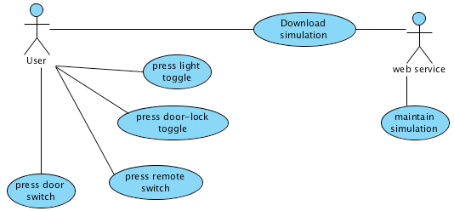
Use Case Model

Slide 3
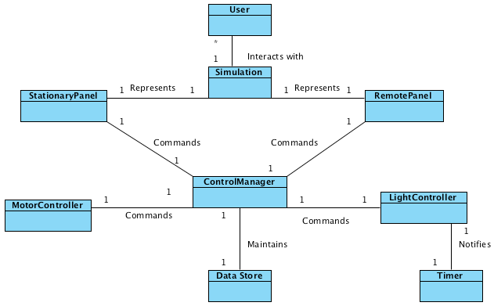
Conceptual Model

Slide 4
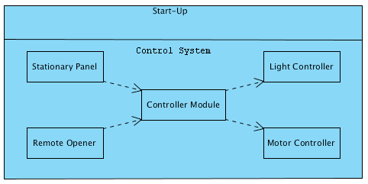
Architectural Model

Slide 5
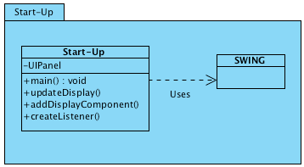
Start-Up Layer

Slide 6
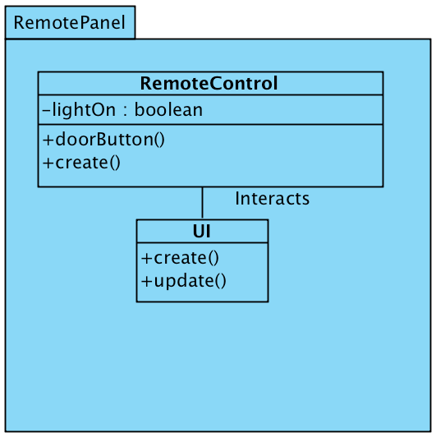
Remote Opener Component

Slide 7
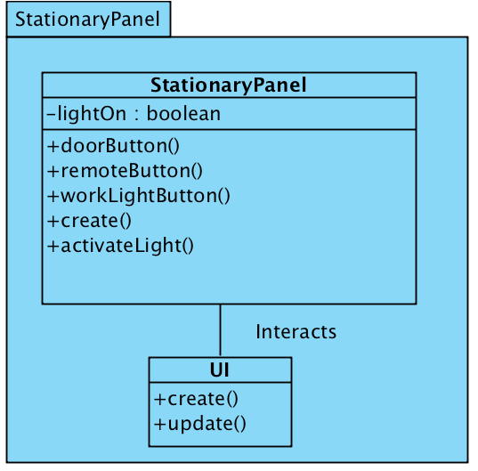
Stationary Panel Component

Slide 8
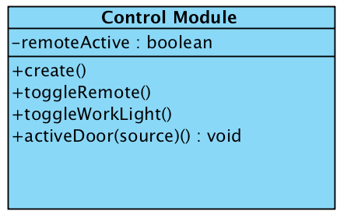
Control Module

Slide 9
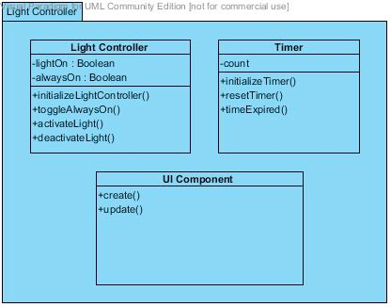
Light Controller Component

Slide 10
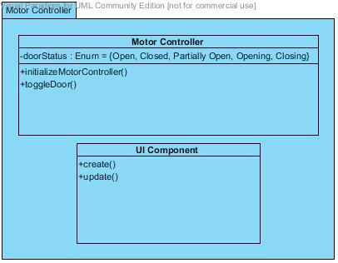
Motor Controller Component

Slide 11
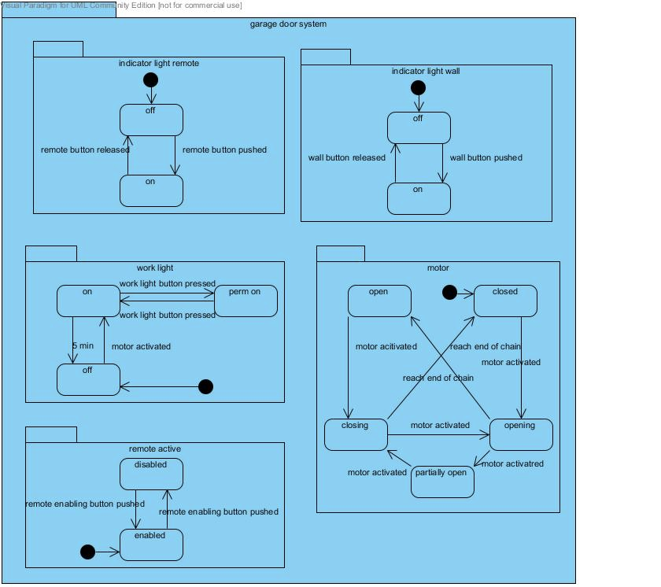
System State Diagram

Slide 12
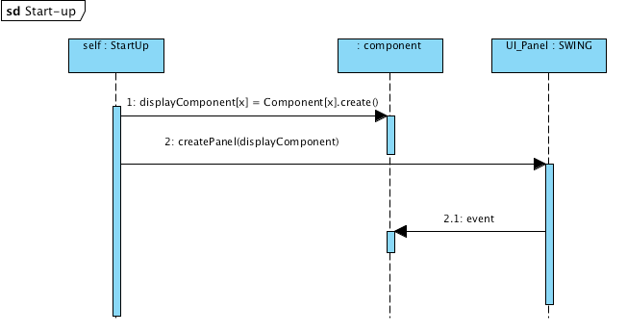
Start-Up Sequence Diagram

Slide 13
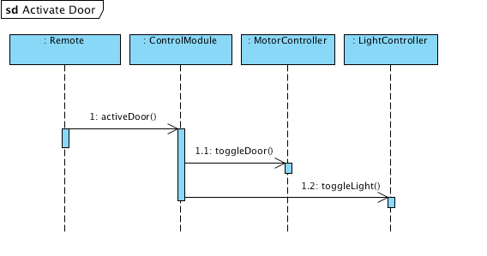
Activate Door Sequence Diagram

Slide 14
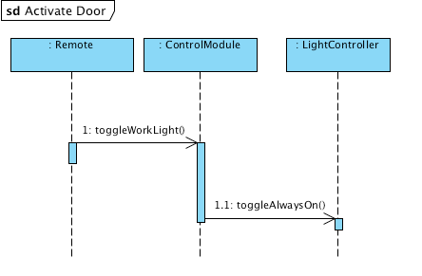
Toggle Light State Sequence Diagram

